Slide 2
Kabul RNAV Visual & RNP-AR Process & Benefits
Roger Hall
RNAV Project Pilot
Emirates Airline

Slide 3
Kabul RNAV Visual & RNP-AR Process & Benefits
Capt Roger Hall
RNAV Project Pilot
Real Scenarios – Increased Predictability
©2015 Emirates. All Rights Reserved.

Slide 4
Overview
Emirates conducts many hundreds of procedures using FMS guidance and with visual reference to terrain. We call these “RNAV Visual” procedures
Why, How, Challenges & Benefits

Slide 5
When do we Produce & use RNAV Visual?
Process only used in special cases, for approaches where visual reference to terrain by pilot is allowed & assured
Generally at isolated airports with special considerations
Not as a substitute for a state instrument procedure
Initiator is always safety, rather than efficiency (although we will explore efficiency as part of the process)

Slide 6
Summary – RNAV Visual
Prefer automation used throughout RNAV Visual approach, to 500ft-1000ft AAL (rather than hand-flown) – enhances PF awareness of terrain and aircraft flight path
Weather minima selected are conservative – generally 2,500ft ceiling and 8km visibility (raised in areas of high terrain)
Offer most benefits at isolated airports with fewer facilities (rather than high-traffic, major international hubs)

Slide 7
Scenario 1: no published approach
?
?
?
?
Rwy 11
Rwy 29
Kabul approach challenges

Slide 8
Cockpit Video – Kabul Rwy 11

Slide 9
Kabul – a number of challenges…
High airport elevation – 5,900 ft
High terrain – all sectors
Limited room to manoeuvre on approach to Rwy 11
Centreline Rwy 11 – not possible

Slide 10
Kabul – a number of challenges…
Unpredictable military & civil traffic
Security concerns (flying south of airport not allowed)
Hot temperatures (3.5 degrees published baro VNAV vertical path becomes actual 3.7 degrees +)
Limited terrain data
30-degree offset Final – not possible – too steep path

Slide 11
Kabul – a number of challenges…
Landing at max landing weight
Tailwinds
No internal guidance to assist pilot to Rwy 11
Pilot view on Downwind Rwy 11, looking toward runway

Slide 12
Kabul – a number of challenges…
Pilot wonders: where should I turn Base?

Slide 13
Kabul – a solution is produced…
Elements add up to unpredictable lateral & vertical approach paths to Rwy 11
Using; limited terrain data, simulator & live evaluation, Emirates developed & published a Company RNAV Visual chart (with associated FMS guidance)

Slide 14
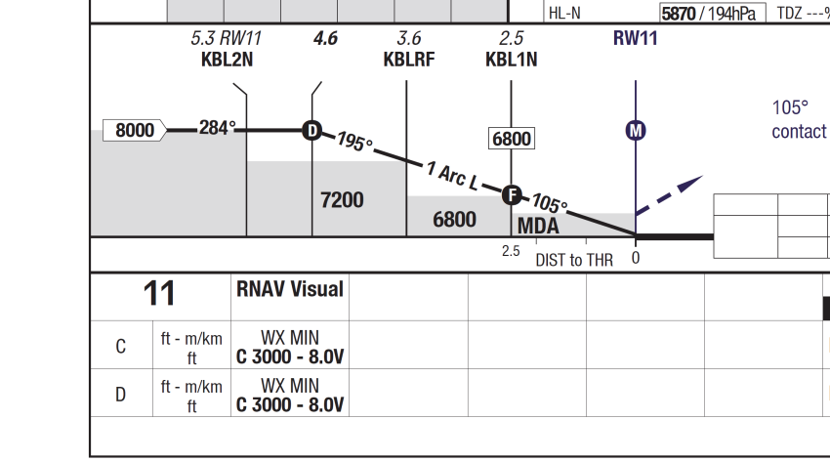
Kabul – a brief look at chart…

Slide 15
Kabul – a look at pilot briefing guide…

Slide 16
Kabul – Results…
Increased predictability (Pilot, Company & ATC)
Reduced rate of descent on Final
Increased safety for all
Reduced returns to home base without landing
Increased efficiency

Slide 17
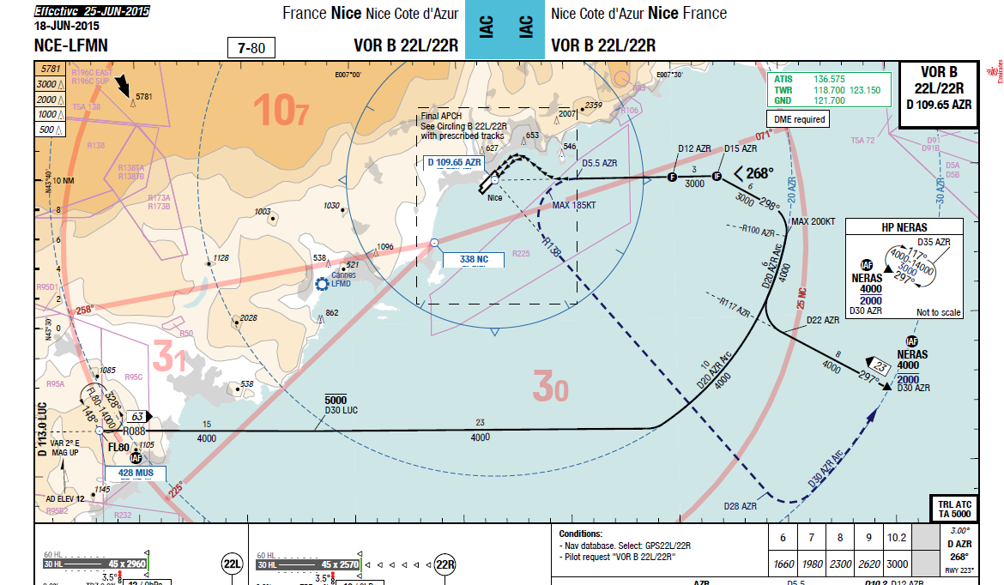
Scenario 2: FMS Guidance ends before Rwy Threshold

Slide 18
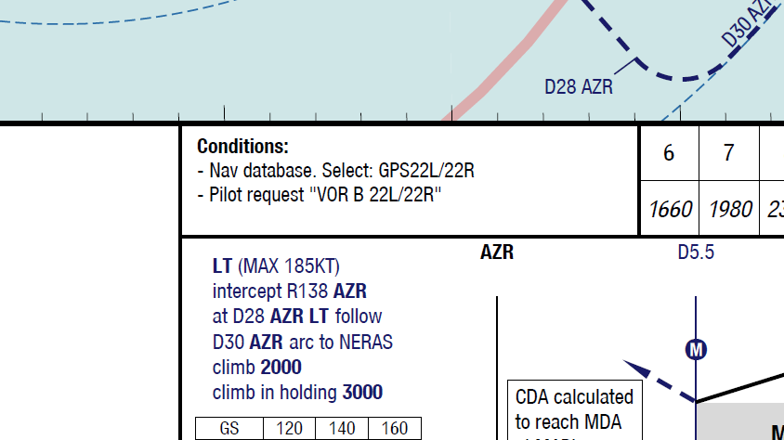
Scenario 2: FMS Guidance ends before Rwy Threshold

Slide 19
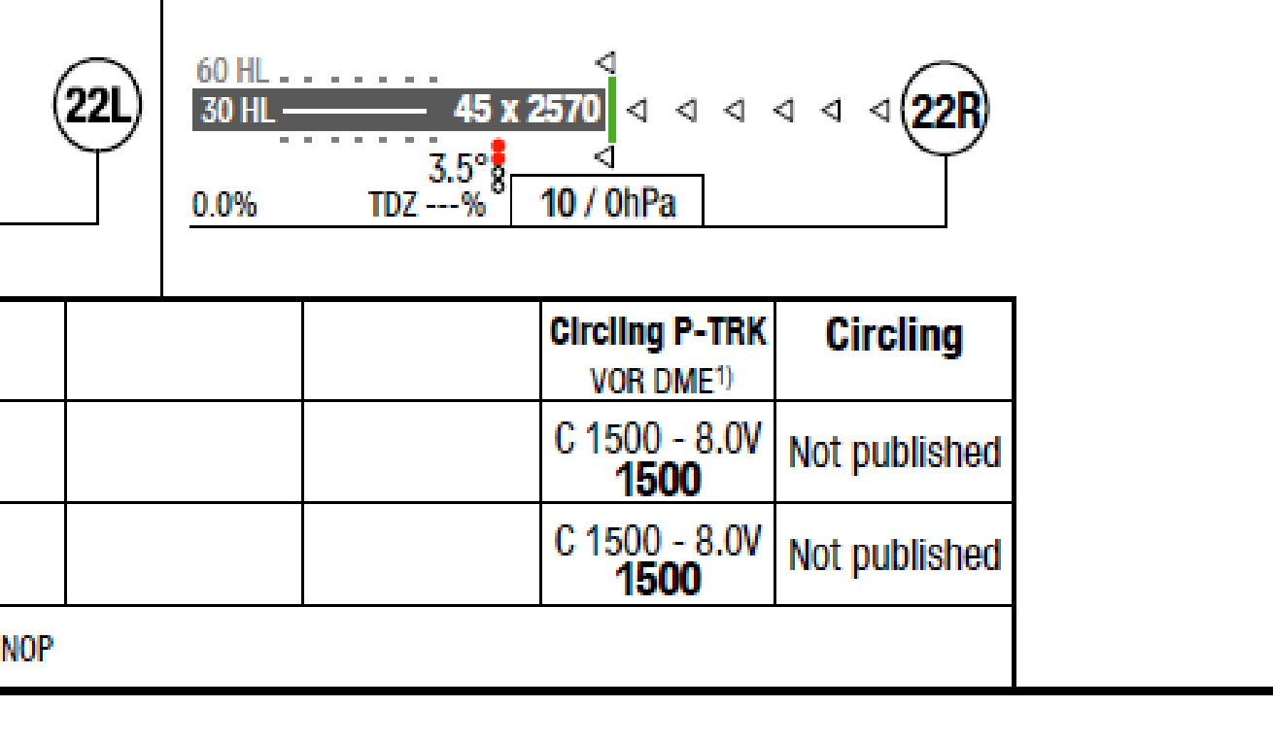
Scenario 2: No FMS Guidance to Rwy Threshold
Visual procedure - allows us freedom to do this

Slide 20
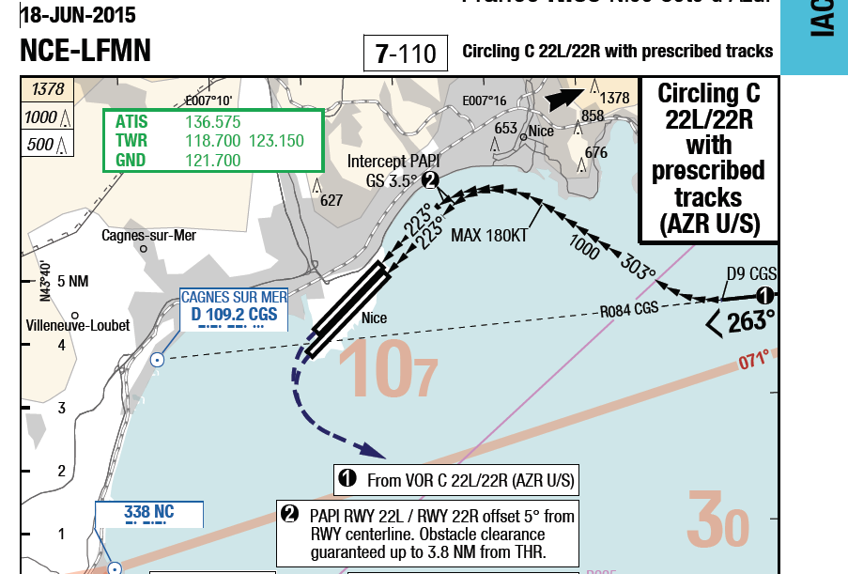
Scenario 2: No FMS Guidance to Rwy Threshold
Pilot uses state chart, but with Company FMS coding and visual reference to terrain…

Slide 21
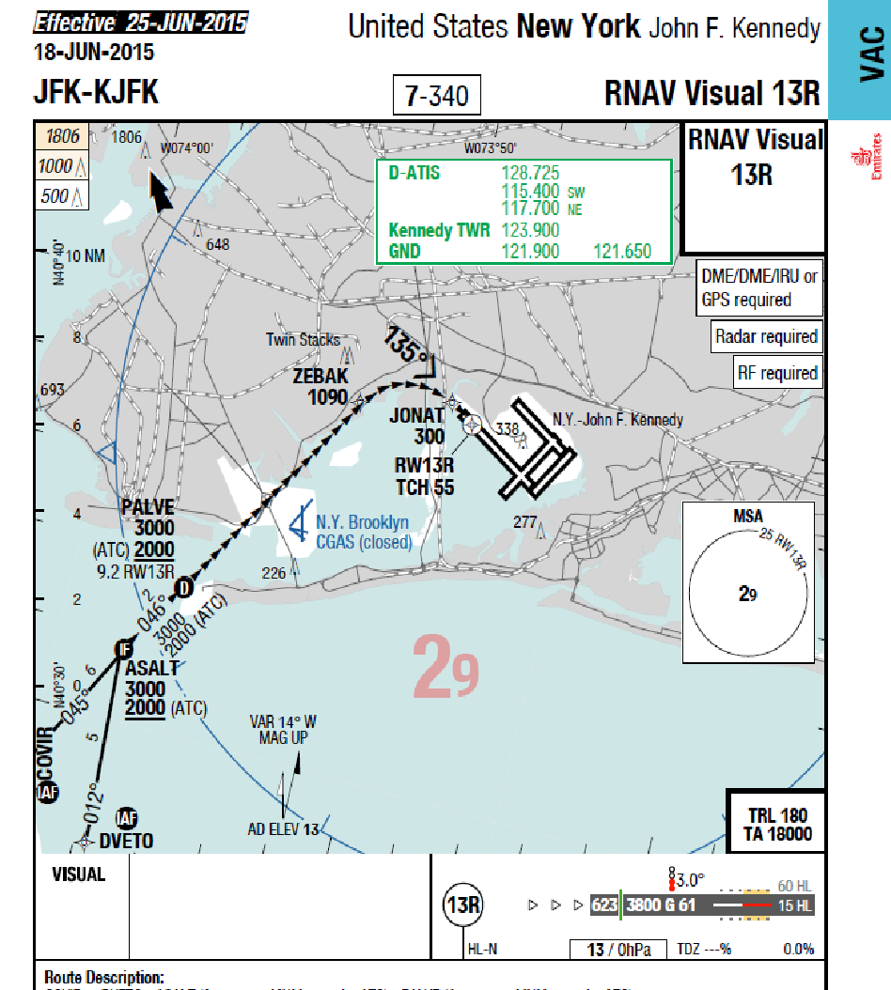
Scenario 3: Published RNAV Visual approach

Slide 22
Scenario 4: Published RNAV approach used as Baseline to Reduce Vertical Path Angle

Slide 23
Scenario 4: Published RNAV approach used as Baseline to Reduce Vertical Path Angle

Slide 24
Summary – RNAV Visual
Our experience has been; providing enhanced FMS guidance to pilots (within a safe and effective process) during a visual phase is nearly always better than providing no guidance at all
Results have shown increased predictability, lower rate of safety events, greater efficiency
Particularly helpful in reducing excessive bank angles, excessive rates of descent and unstable approaches
Less stressful for crew, enables them to better prepare for approach

Slide 25
Kabul Rwy 29 ILS-to-RNP Missed Approach
Capt Roger Hall
RNAV Project Pilot
Enhancing Reliable Services to Kabul
©2017 Emirates. All Rights Reserved.

Slide 26
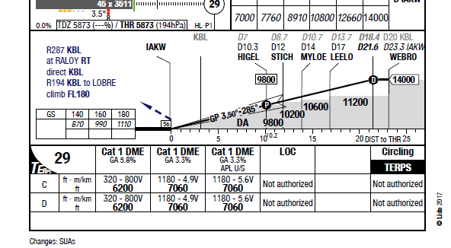
Overview
Any approach minima below 7060 ft minima requires a 5.8% climb gradient instead of 3.3%
20-30 times a year, Emirates has to offload planned cargo from Dubai-Kabul, whenever the KBL forecast or reported cloud ceiling is below approx. 7,500ft to meet this gradient

Slide 27
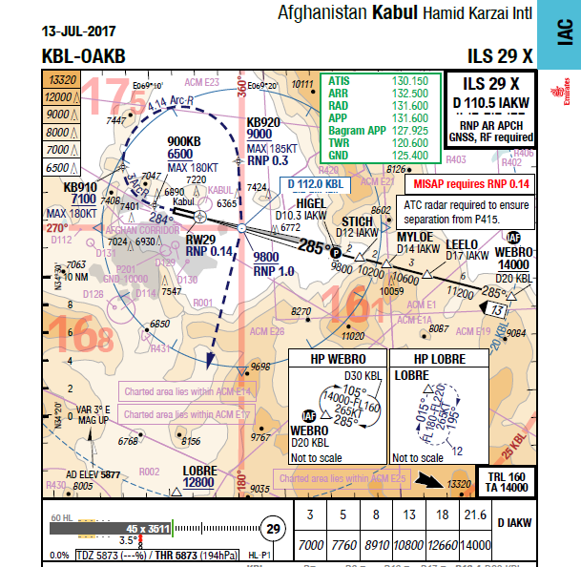
Solution
Using proven, regulator-approved principles and guidelines, Emirates paid to have special missed-approach design work done
Allows use of the existing ILS approach facility at Kabul, to lower minimums – with a lesser missed-approach climb gradient

Slide 28
Solution
One of our main goals was minimum disruption to KBL ATC services – using the existing ILS for the approach portion achieves this
Regulator-approved design agency DFS (state provider for Germany) was retained for special terrain examination and design work

Slide 29
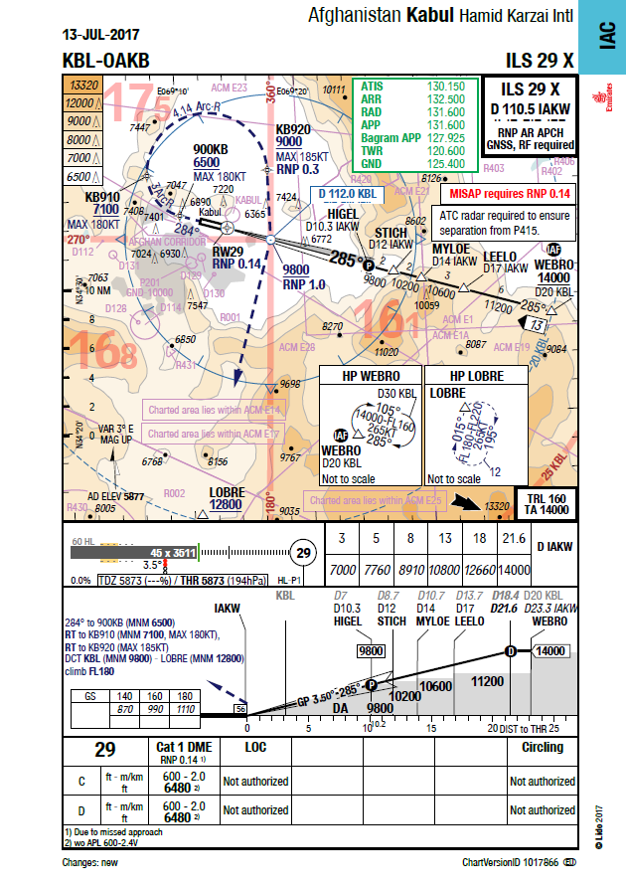
Solution
Here’s a look at the full approach plate

Slide 30
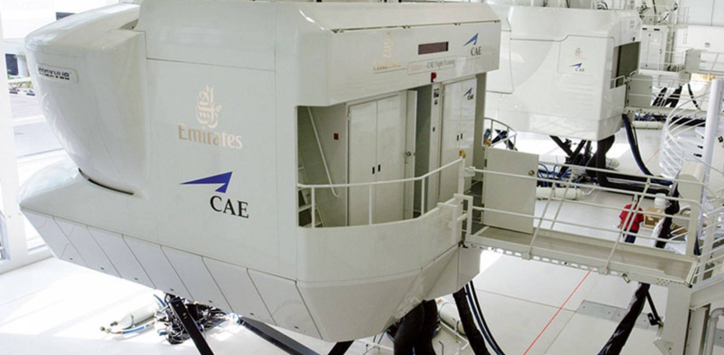
Development Process
Terrain & track analysis with special software
Performance analysis by Emirates specialists
Multiple Simulator evaluations
Certification from DFS

Slide 31
Simulator Video – Kabul Rwy 29
Engine-out simulation

Slide 32
Kabul Rwy 29 Missed Approach…
High airport elevation – 5,900 ft
High terrain – all sectors
Limited room to manoeuvre on missed approach to Rwy 29
looking towards Rwy 11 – reverse path of missed approach

Slide 33
RNP-AR Missed Approach…
Using; certified capability of the Boeing 777 (down to RNP 0.11) Emirates developed & published a new missed approach procedure with an RNP value of 0.14

Slide 34
Kabul – Results…
Increased landing predictability (Pilot, Company & ATC)
Fewer diversions
Reduced load on ATC (due to missed approaches & diversions)
Reduced returns to home base without landing
Little-to-no ATC training required – just awareness

Slide 35
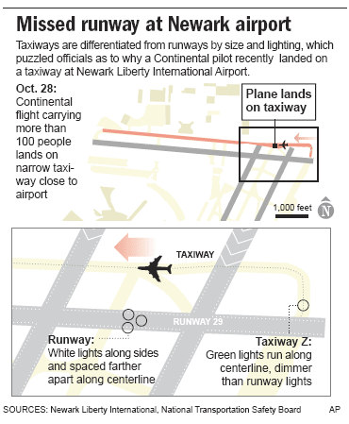
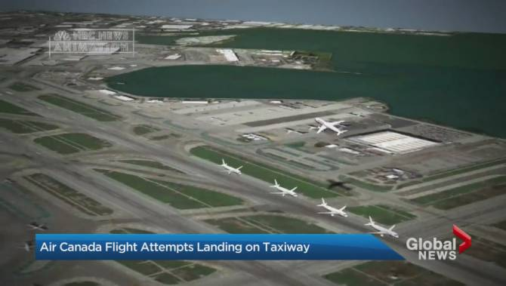
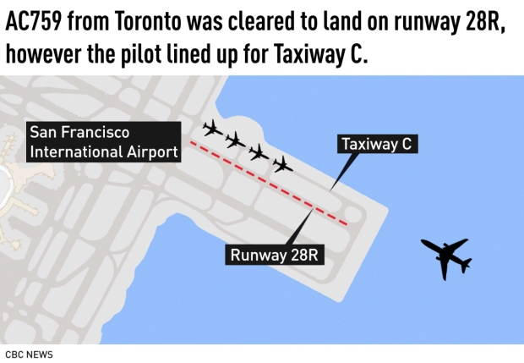
How can we Encourage Landings on the Correct Surface?
Should we progress, away from “100% visual” approaches?

Slide 36
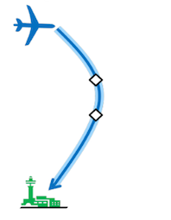
Is “RNAV Final” Clearance a Possible Solution?

Slide 37
Summary
RNAV query toward enhancing safety?
Please contact:
roger.hall@emirates.com
roger@xflashsystems.com

